Slide 1
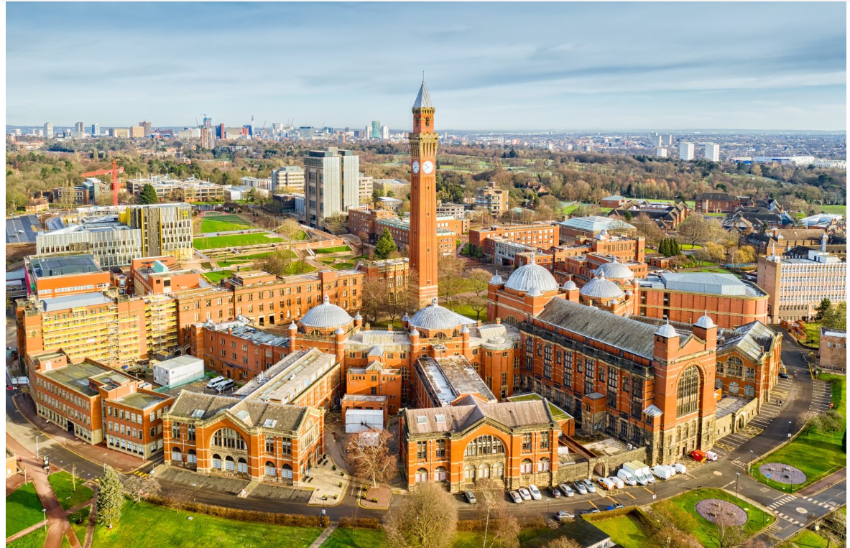
Source: Shutterstock

Slide 2
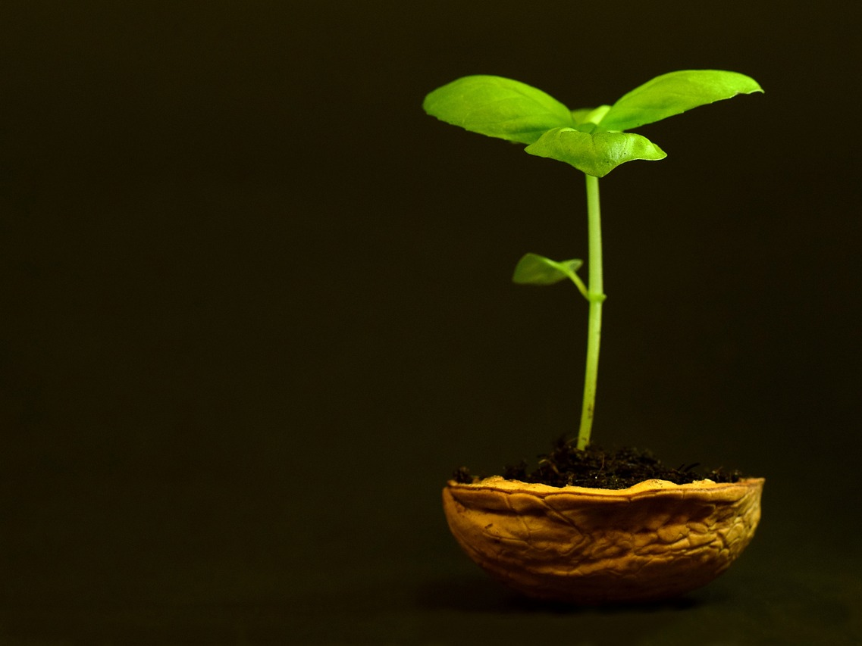
Is salt bad for plants?

Slide 3
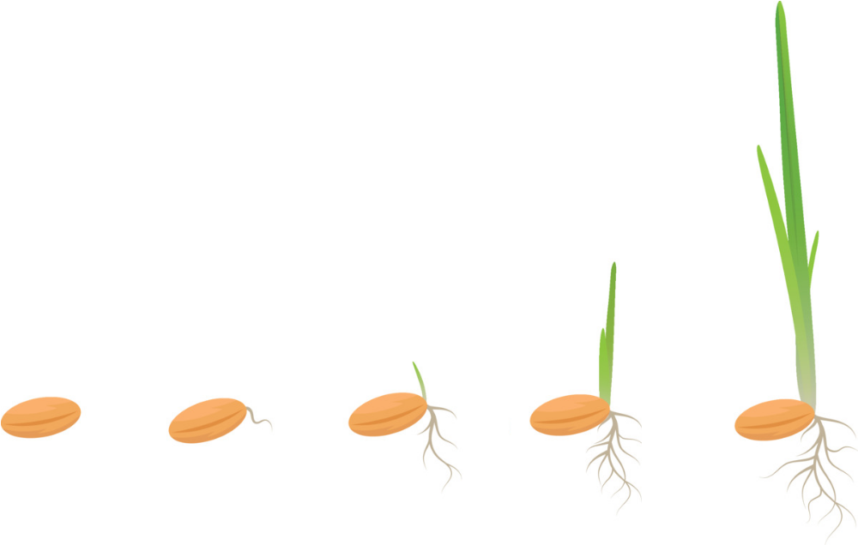
What’s a seed?

Slide 4
What are we going to do?
We’ll try a few experiments
Zero salt
Low salt
Medium salt
High salt!

Slide 5
We need to label our experiments
Filter paper
Low

Slide 6
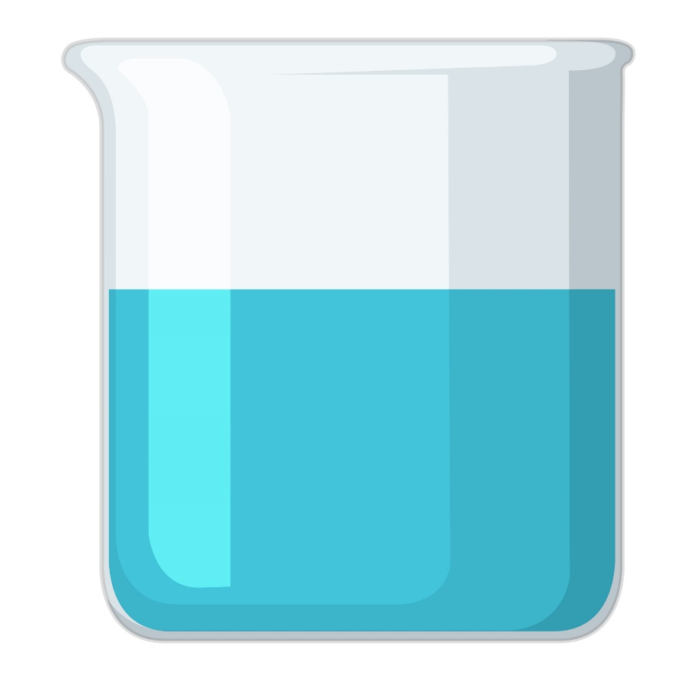
We need to soak the filter paper

Slide 7
We need to count 10 seeds!
Filter paper

Slide 8
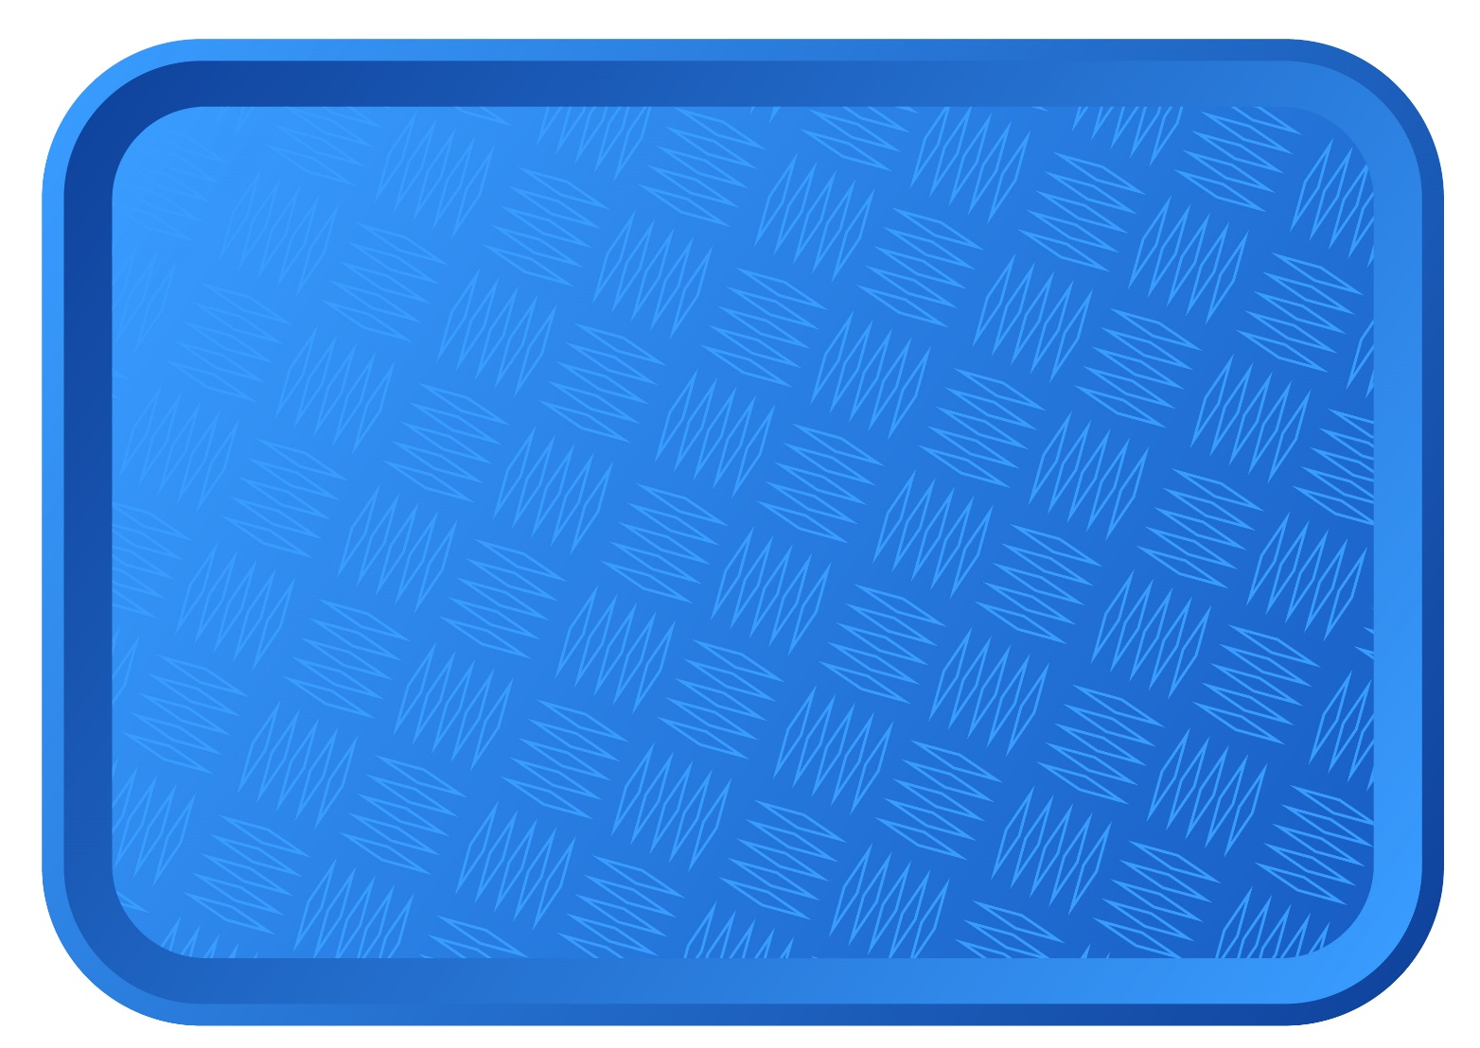
Put all your experiments in your tray
Make sure your names are on your tray!

