Slide 1
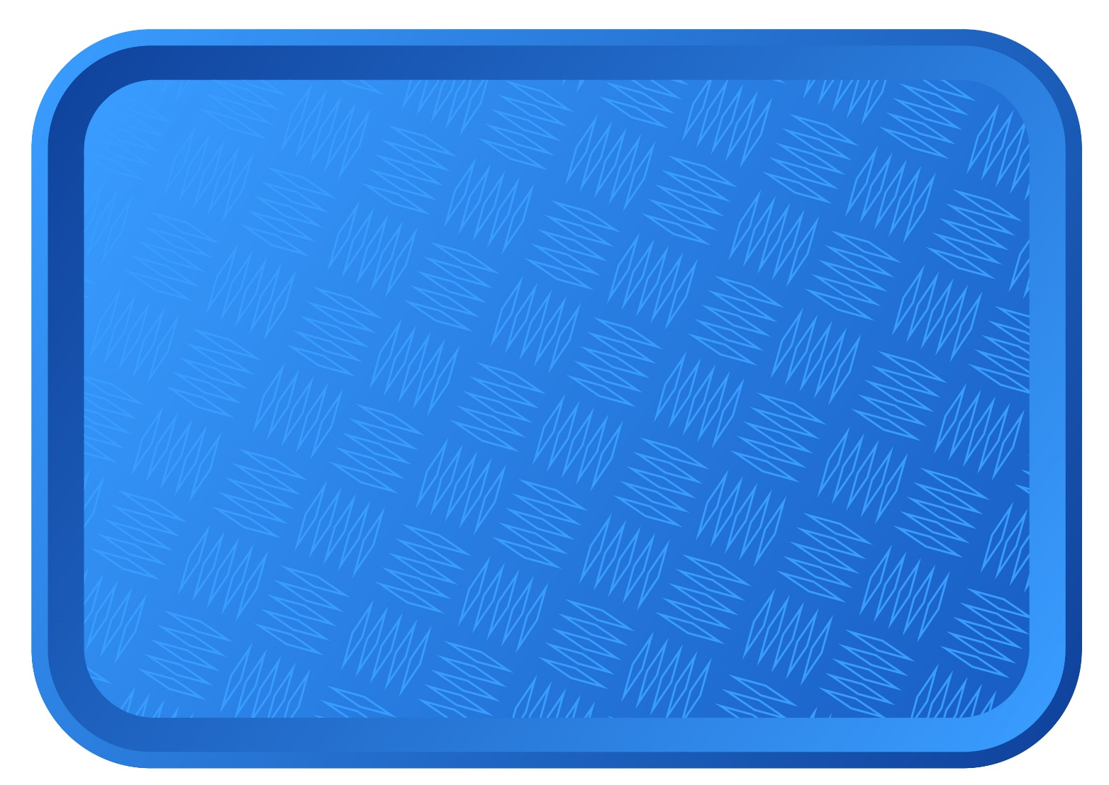
Do you remember what you did last week?
0
0
low
low
medium
medium
high
high
Notes:
Use this slide if Gratnell trays were used. Ask for predictions.

Slide 2
Do you remember what you did last week?
0
medium
low
high
Notes:
Use this slide if small trays were used. Ask for predictions.

Slide 3
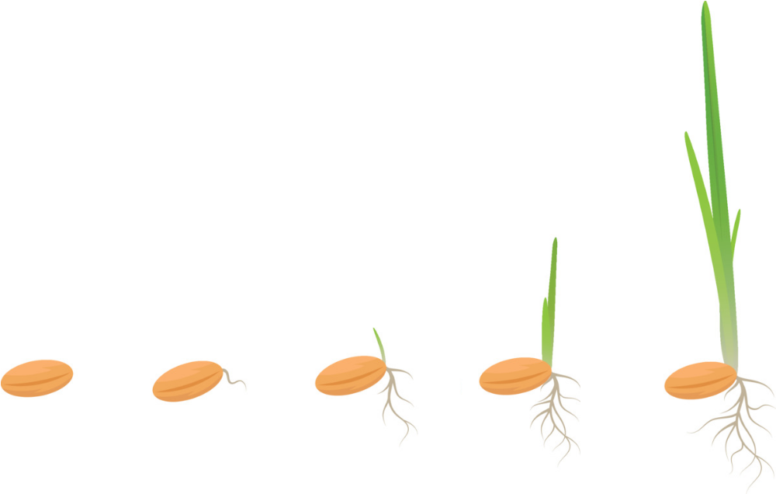
Today, we are going to look at our results and draw some graphs to show them!
Notes:
Talk about graphs – what sort of graphs have they done? Do our volunteers use them?
Pupils can now collect their trays and have a look at their results!

Slide 4
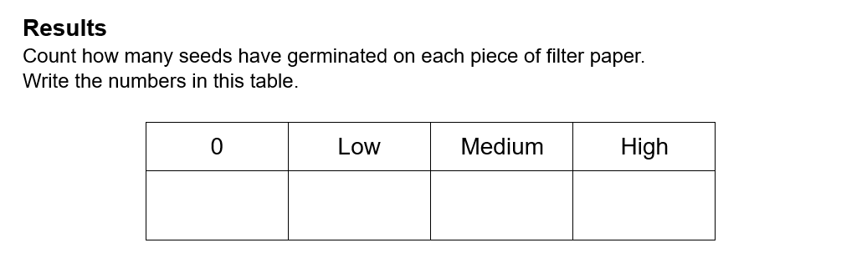
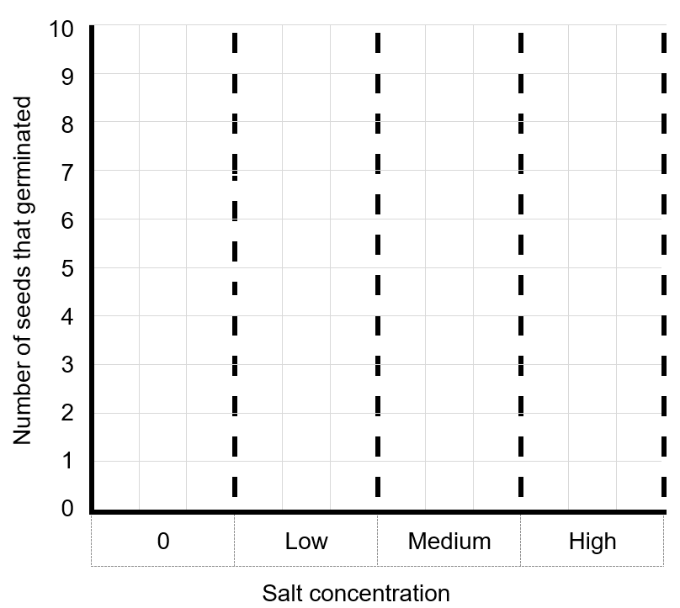
4
Notes:
Even if there’s just a tiny shoot, they can count this as having germinated. Discuss how a graph can make results look a lot clearer. Students can now begin to count their seeds and draw their graphs. Volunteers to assist and possibly discuss conclusions / second graph with some if necessary.

Slide 5

1) Which concentration was best for germination?
2) Is there a pattern in your results?
What happened to the number of germinated seeds as the
concentrations got stronger?
As the concentrations got stronger, the number of germinated seeds…
Notes:
What does this mean? ‘Conclusion’ as ‘the end’ of something, so it’s the last thing we do.

Slide 6
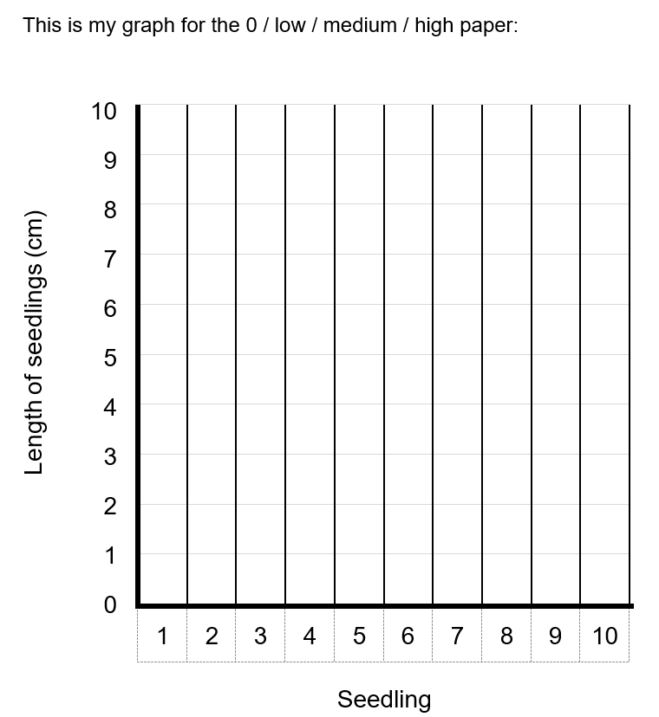
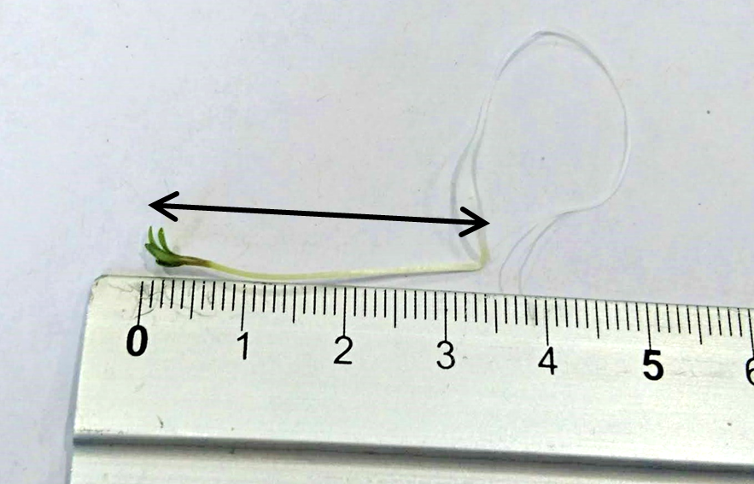
One person can draw a graph for the medium concentration.
The other person can draw a graph for the high concentration.
Notes:
Is there another way we can show our results? Look at your medium or high seeds – what do you notice (different lengths). This gives us a more accurate idea of what’s happened. NOTE we aren’t counting the length of the white root – just the green shoot.

Slide 7
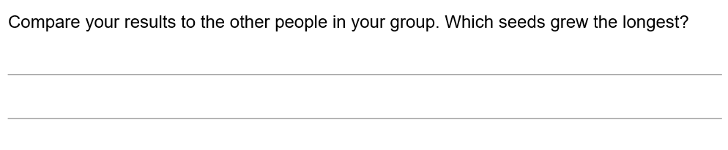

Slide 8

What are we going to do next?
You can try your own experiment now!
You can use different liquids or different
strengths of the same liquid.
Notes:
The groups will need some help if using different concentrations – just use one beaker, soak the paper, then add more sugar etc and repeat. No need to worry about measuring quantities of sugar etc as this will be too time-consuming.

Slide 9
Remember to count 10 seeds and label your filter paper.

Slide 10
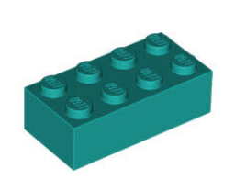
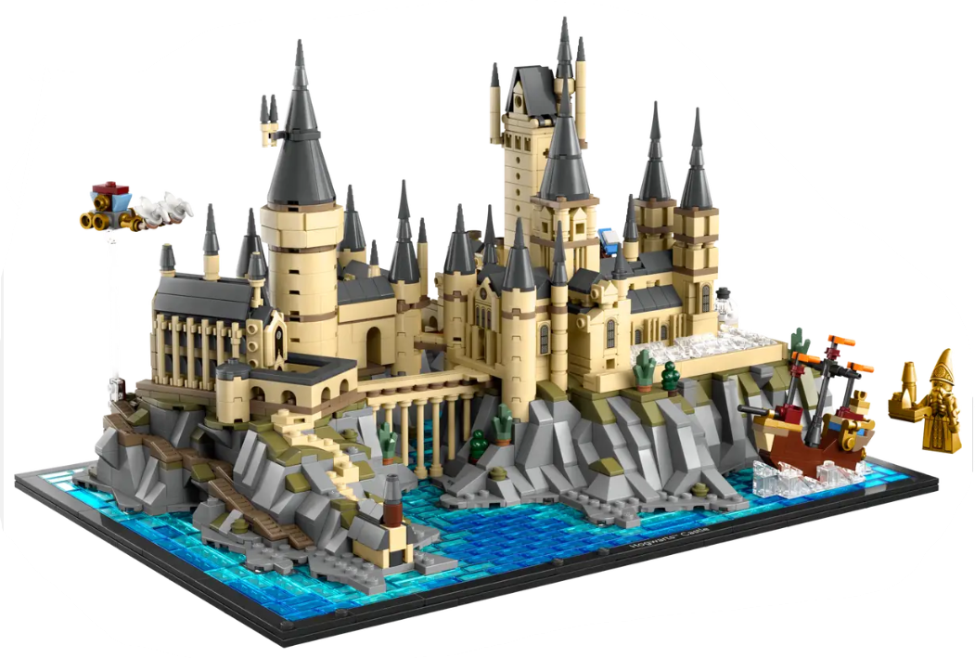
Cells are like Lego bricks.
Just like you can use lots of Lego bricks to make complicated models, every living thing is made up of cells – but cells are tiny!

Slide 11
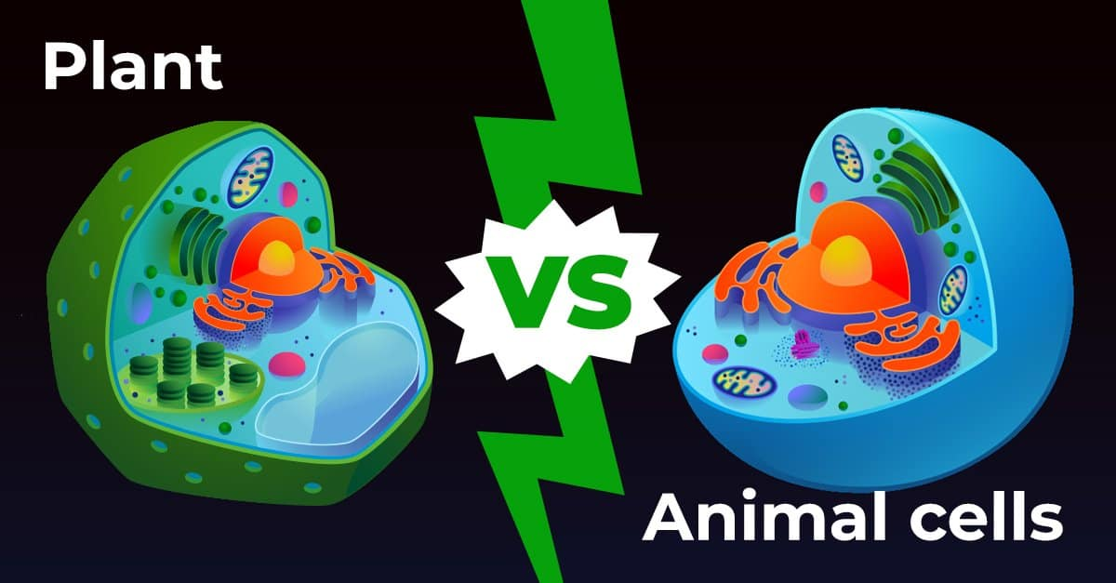

Slide 12
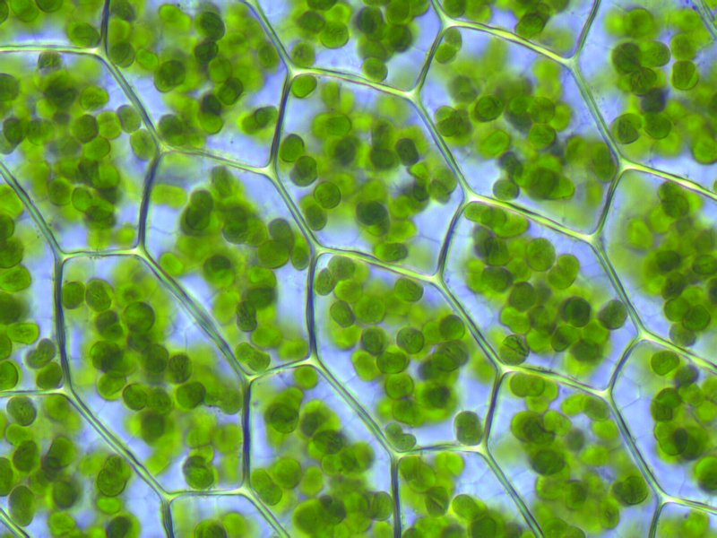
Cells
Video
Watch the video and write down two things you would find in both a plant and an animal cell.

Slide 13
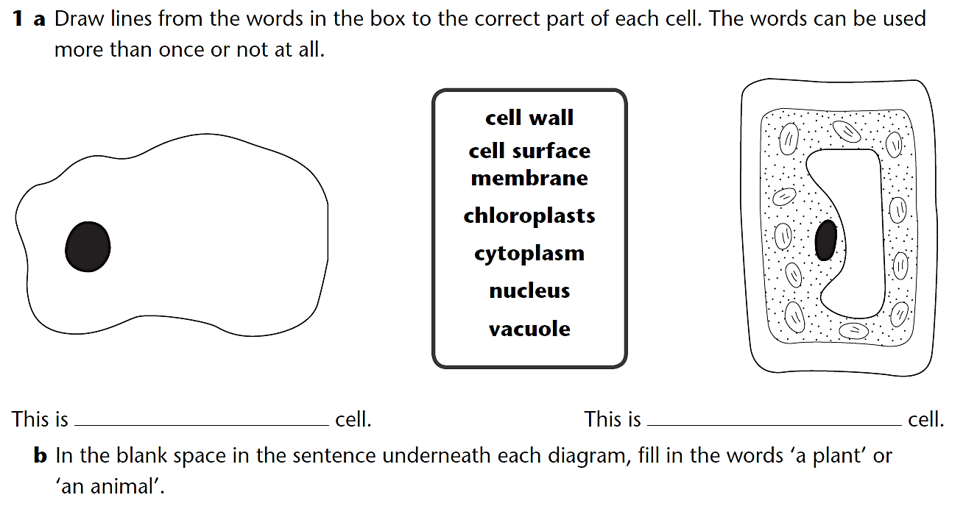
an animal
a plant

Slide 14
Bitesize

